Slide 1
Search As A Technique
Litty Tressa George
FICT

Slide 2
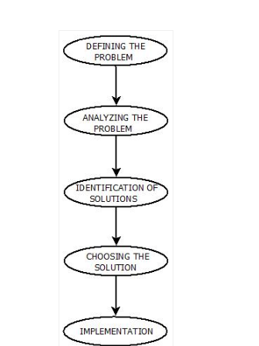
Problem Solving Steps
The process of solving a problem consists of five steps. These are:

Slide 3
Search as a Technique for Problem Solving
Problem solving is an important aspect of Artificial Intelligence.
A problem can be considered to consist of a goal and a set of actions that can be taken to lead to the goal.
For example, consider the problem of looking for a contact lens on a football field. The initial state /start state is that the lens is somewhere on the field, but we don’t know where. If we use representation for examining the field in units of one square foot, then our first action might be to examine the square in the top-left corner of the field. After a number of actions, the state might be that we have examined 500 squares, and we have now just found the lens in the last square we examined. This is a goal state because it satisfies the goal that we had of finding a contact lens.

Slide 4
Search as a Technique for Problem Solving
Search is a method that can be used by computers to examine a problem space in order to find a goal.
A problem space can also be considered to be a search space because in order to solve the problem, we will search the space for a goal state.
There are a number of methods for examining a search space, and they are called search methods.
In general, searching refers to as finding target information or goal that is aimed.
Searching is of the most commonly used technique of problem solving in artificial intelligence.
The searching algorithms helps us to easily search for solutions that exist in the problem space.

Slide 5
Search Categorizations- 2 Types of Search
(on the basis of how search is occurring)
Data-driven search
Goal-driven search
Data-driven search starts from an initial state and uses actions that are allowed to move forward until a goal is reached. This approach is also known as forward chaining. It is a Top Down Approach
Alternatively, search can start at the goal and work back toward a start state, by seeing what moves could have led to the goal state. This is goal-driven search, also known as backward chaining. It is a Bottom Up Approach

Slide 6
Goal-driven search is particularly useful in situations in which the goal can be clearly specified (for example, a theorem that is to be proved
or
finding an exit from a maze).
It is also clearly the best choice in situations such as medical diagnosis where the goal (the condition to be diagnosed) is known, but the rest of the data (in this case, the causes of the condition) need to be found.
Data-driven search is most useful when the initial data are provided, and it is not clear what the goal is.
Goal-driven search is mostly applied when we are provided with the target information, and we need to find out how is it attained.
Goal-driven search and data-driven search will end up producing good results, but depending on the nature of the problem being solved, and information available or provided we have to decide which one should be applied..

Slide 7
Search Terminology
Problem Space − It is the environment in which the search takes place. (A set of states and set of operators to perform operations/actions to change those states) A problem space can also be considered to be a search space.
Problem Space Graph − It is the graphical representation of problem states. States are shown by nodes and operators are shown by edges.
Depth of a problem − Length of a shortest path or shortest sequence from initial State to goal state.

Slide 8
Space Complexity − The space complexity is related to the amount of memory that the method uses to store its specific information.
Time Complexity − The time complexity of a method is related to the length of time that the method would take to find a goal state
Admissibility − A property of an algorithm to always find an optimal solution.
Branching Factor − The average number of child nodes in the problem space graph.
Completeness- A search method is described as being complete if it is guaranteed to find a goal state if one exists.

Slide 9
Evaluation Criteria's For Finding The Right Search Strategy
The majority of work in the area of search has gone into finding the right search strategy for a problem.
We will evaluate strategies in terms of four criteria:
Completeness: Is the strategy guaranteed to find a solution when there is one?
Time complexity: How long does it take to find a solution?
Space complexity: How much storage space does it need to perform the search?
Optimality: Does the strategy find the highest-quality solution when there are several
different solutions?

Slide 10
Search Algorithm Classification
Searching is a process to find the solution for a given set of problems.
This in artificial intelligence can be done by using either uninformed search algorithmic strategies of either informed search algorithmic strategies.
Un-Informed Search Strategy
Informed Search Strategy

Slide 11
Un-Informed Search Strategy
Uninformed search algorithms are a class of general-purpose search algorithms which operates in brute force-way.
Uninformed search algorithms do not have additional information about the problem domain other than Initial state & Goal state description , so it is also called blind search.
Un-Informed search strategy includes two basic search techniques. These are:
Breadth First Search.
Depth First Search

Slide 12
Following are the various types of uninformed search algorithms
Breadth-first Search
Depth-first Search
Depth-limited Search
Iterative deepening depth-first search
Uniform cost search
Bidirectional Search

Slide 13
Informed / Heuristic Search
Take the example of looking for a suitable Christmas gift.
Very few people would simply walk into each shop as they came across it, looking in each department in turn until they see a present that they desired .
Most people would go straight to the shop that they considered to be most likely to have a suitable gift.
If no gift was found in that shop, they would then proceed to the shop they considered to be the next most likely to have a suitable gift using information from their previous experience.
This kind of information is called a heuristic.

Slide 14
Heuristic Search
Search methods that use heuristics and are thus thought of as heuristic search methods, or heuristically informed search methods.
A search method or heuristic is informed if it uses additional information about nodes that have not yet been explored to decide which nodes to examine next.
The heuristic method, however, might not always give the best solution, but it guaranteed to find a good solution in reasonable time.
A search method is described as monotone if it always reaches a given node by the shortest possible path.
A monotonic heuristic is a heuristic that has this property.
An admissible heuristic is a heuristic that never overestimates the true distance of a node from the goal.

Slide 15
Informed Search Techniques
Best-First Search
A* Search
Bidirectional Search
Tabu Search
Beam Search
Simulated Annealing
Hill Climbing
Constraint Satisfaction Problems

Slide 16
Search- Basic Concepts/Terminologies
Basic elements of a search problem definition are the States , Actions And Goal
Initial State
The state from which the agent infers that it is at the beginning
State Space
Set of all possible states
Actions
Description of possible actions and their outcome
(successor function)
Goal & Goal Test
Tests whether the state description matches a goal state

Slide 17
Path
A sequence of actions leading from one state to another.
Cost
The function applied
Path Costs
Usually the sum of the costs of the actions along the path.
Solution
Path from an initial to a goal state
Search Costs
Time and storage requirements to find a solution
Total Costs
Search costs + path costs

Slide 18
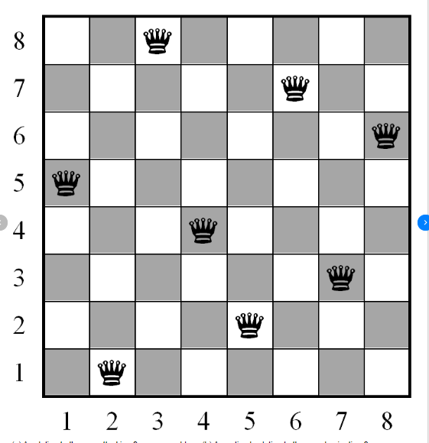
Example: 8-Queens Problem
Almost a solution:
States:
Any arrangement of 0 to 8 queens on the board.
Initial state:
No queen on the board.
Successor function:
Add a queen to an empty field on the board.
Goal :
8 queens on the board such that no queen attacks another i.e.; solution requires that no two queens share the same row, column, or diagonal

